Slide 1
DIGITAL PORTFOLIO STUDENT NAME: NISHANTHI . R REGISTER NO AND NMID:24131130500122011 /asanm1132413113180522011 DEPARTMANT: B.SC (computer science) – II year COLLEGE NAME AND UNIVERSITY: 113-VALLALAR ARTS AND SCIENCE COLLEGE,ANNAMALAI UNIVERSITY

Slide 2
PROJECT TITTLE: Designer portfolio

Slide 3
AGENDA: 1.Problem Statement 2.Project Overview 3.End Users 4.Tools and Technologies 5.Portfolio design and Layout 6.Features and Functionality 7.Results and Screenshots 8.Conclusion 9.Github Link

Slide 4
PROBLEM STATEMENT: Designers face challenges in showcasing diverse creative skills effectively. A digital portfolio helps present work in a professional and visually appealing way.

Slide 5
PROJECT OVERVIEW: This portfolio highlights design works across UI/UX, branding, and creative visuals. Goal: To present design expertise, creativity, and problem-solving approach.

Slide 6
END USERS: Recruiters & Companies Clients seeking design services Academic evaluators or professors

Slide 7
TOOLS AND TECHNIQUES: Adobe Photoshop, Illustrator Figma, Canva, Sketch HTML, CSS, JavaScript (for interactive portfolio)

Slide 8
PORTFOLIO DESIGN AND LAYOUT: Clean and minimalistic structure Organized sections: Home, About, Projects, Skills, Contact Visual storytelling through mockups and prototypes

Slide 9
FEATURES AND FUNCTIONALITY: Interactive navigation Responsive design for mobile & desktop Downloadable resume and contact form integration

Slide 10
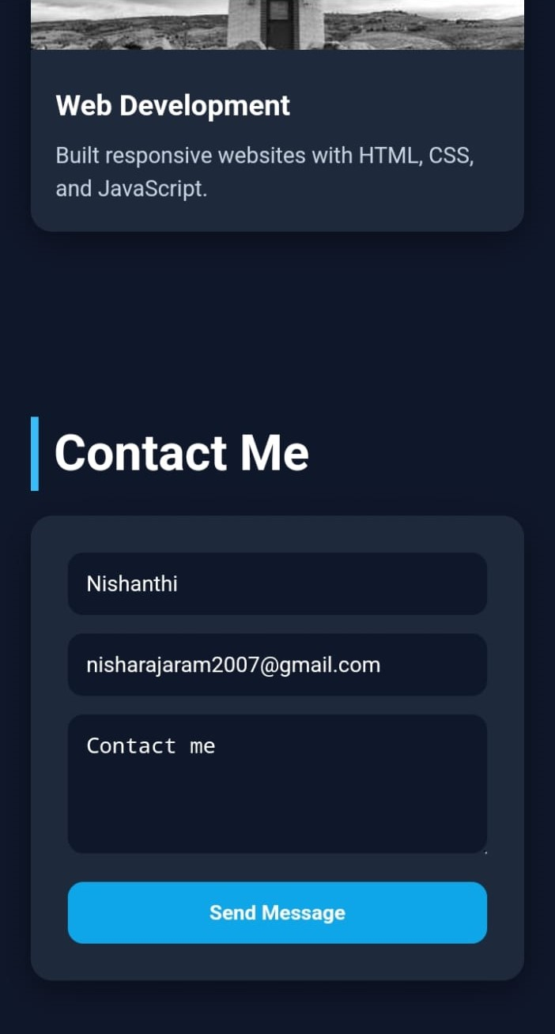
RESULTS AND SCREENSHORT: Show sample designs (logos, UI mockups, posters, etc.) Highlight before/after transformations.

Slide 11
CONCLUSION: A well-crafted designer portfolio reflects creativity, skills, and professionalism. Helps in career opportunities, freelance projects, and personal branding.

